Slide 1
Etsy Test
Group 10
Jacob Igel and Samuel Vaughan

Slide 2
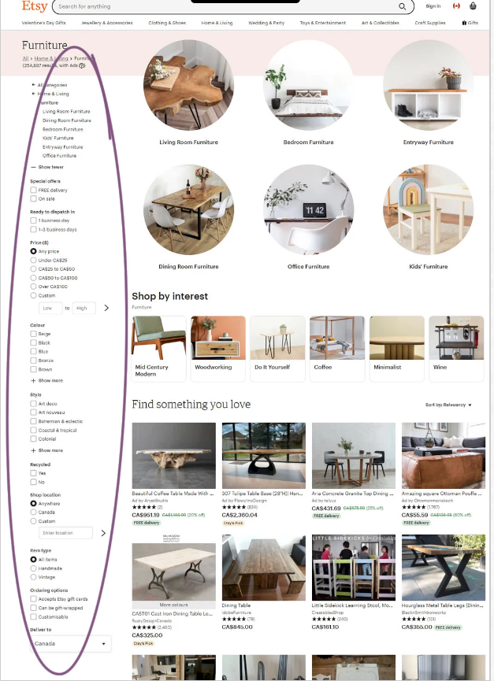
Control Group

Slide 3
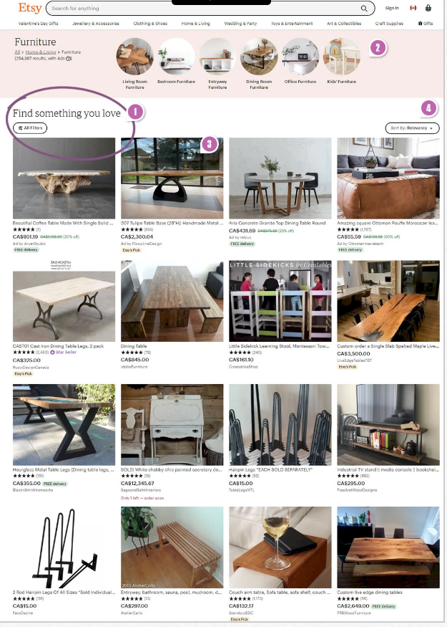
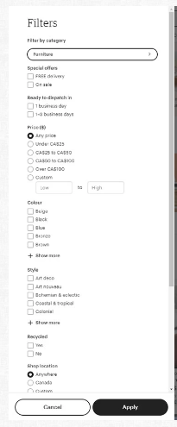
Version B

Slide 4
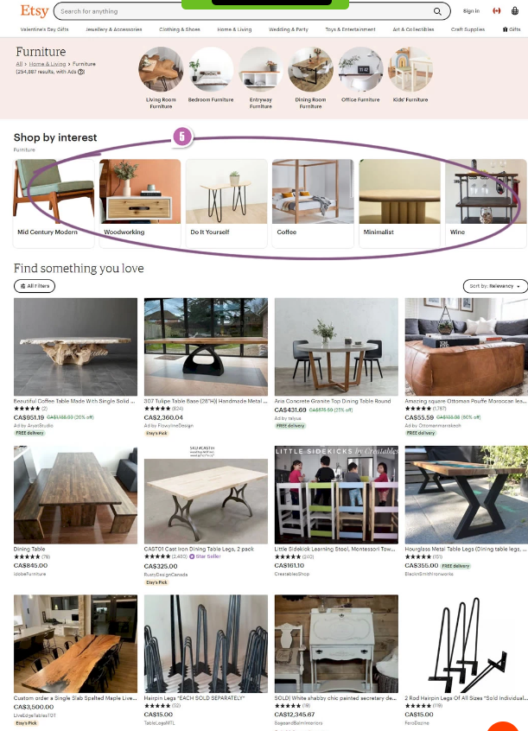
Version C

Slide 5
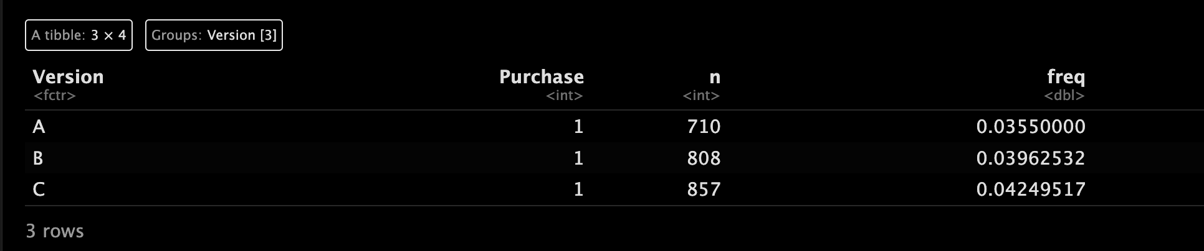
Comparing Proportions
We can see that Version C is the version with the highest amount of visits. (857)
Version A has the least amount of views. (710)

Slide 6
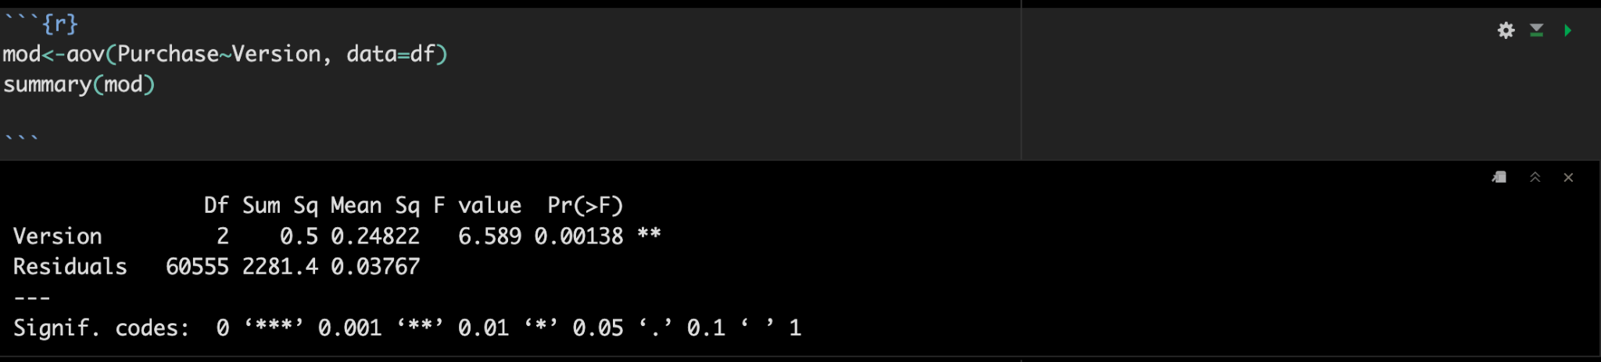
Testing to see if there is a difference in means
One of the different pages is producing a different mean visits. (p-value:0.00138)

Slide 7
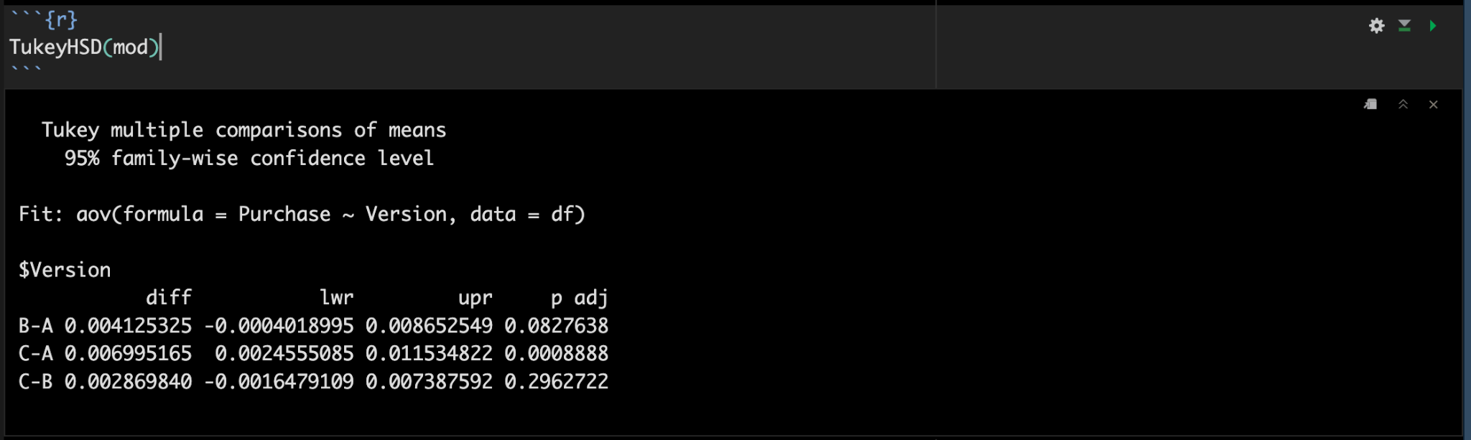
Comparing Means
B and C is has a larger amount of views than A. (.0827, .0008)
From this output we see that the C is not different from B. (p-value = .29)

